Slide 1



What
Will We
Learn?
?
Fullstack

Slide 2
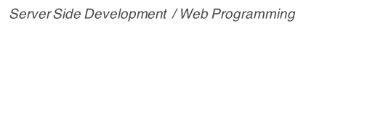


What is
OOP?
Style

Slide 3

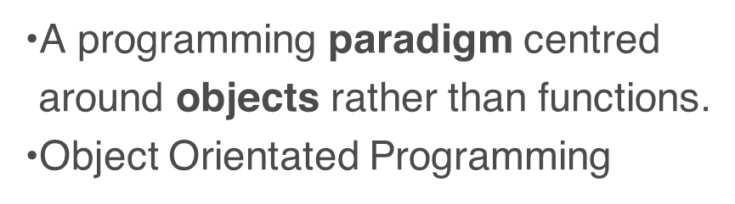
OOP
It’s a style of programming

Slide 4
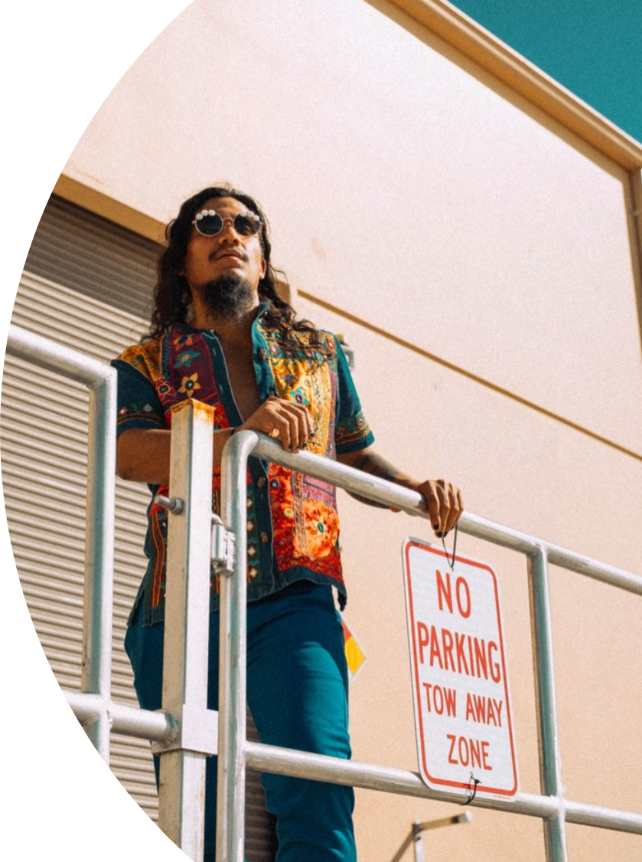
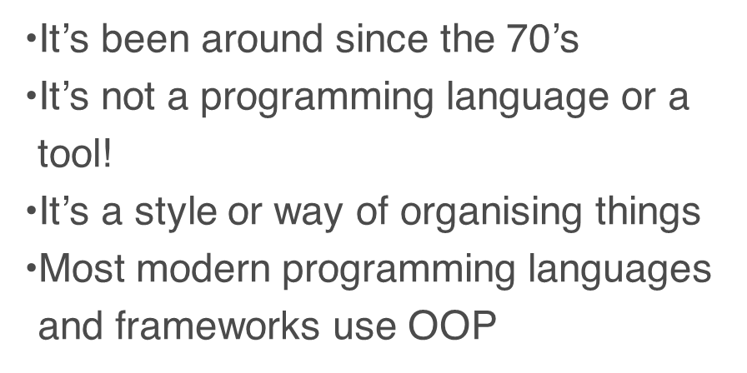
OOP
But it is still every relevant

Slide 5
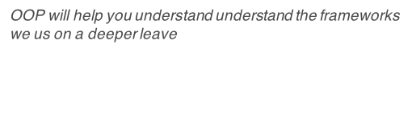

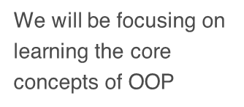
“
Learning
OOP
Principles

Slide 6

Most programming languages use Classical OPP

Slide 7

But JavaScript is not a Classical OOP Language
It is a Prototype Based Language

Slide 8

We can write JavaScript using:
Classical OOP
&
Prototype OOP

Slide 9

We will begin by learning Classical OOP
Then we will move to Prototypical

Slide 10

Many of the concepts are very similar.

